Slide 1
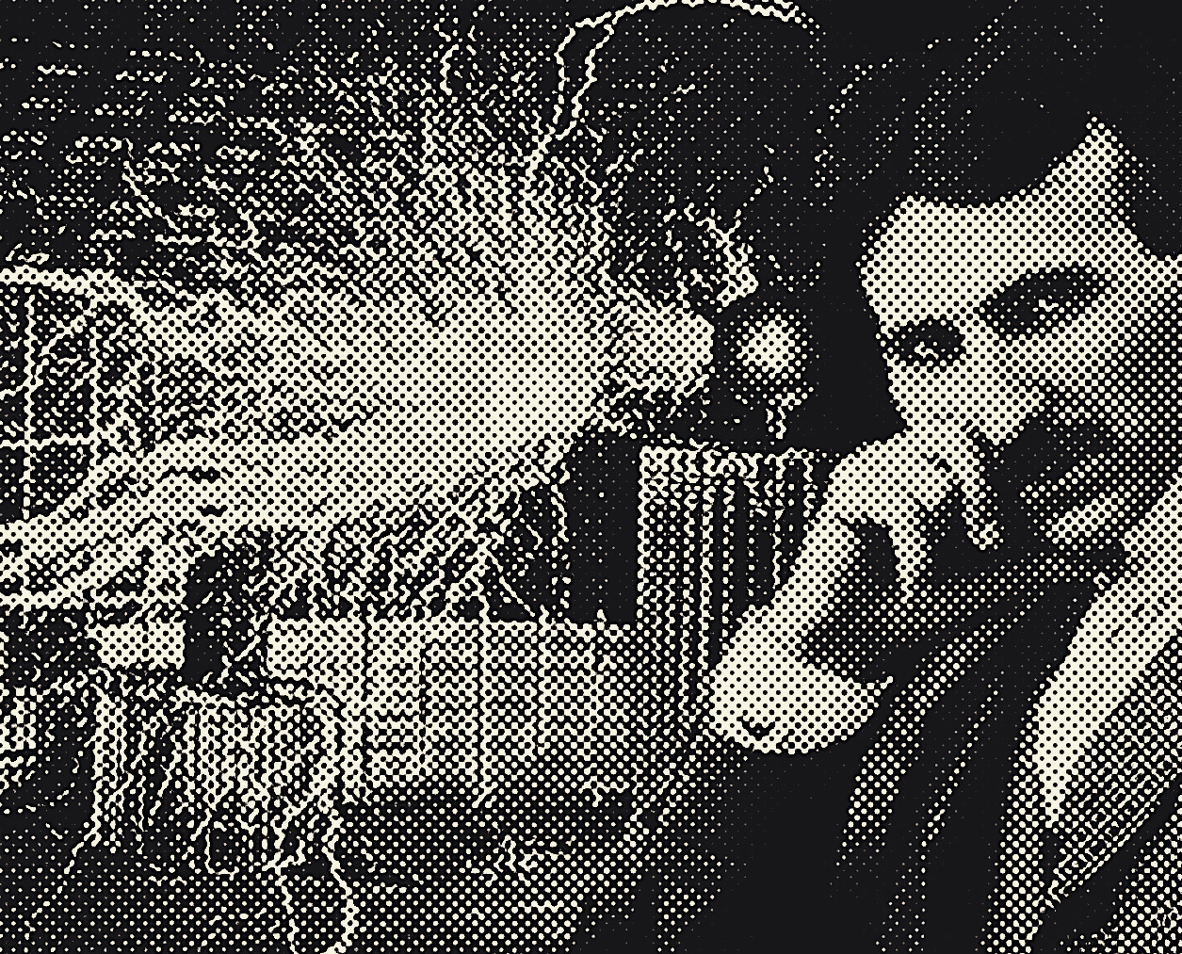
Tesla
Daniele Toniolo
Aleksei Cepach Belov
Federico Peselli

Slide 2
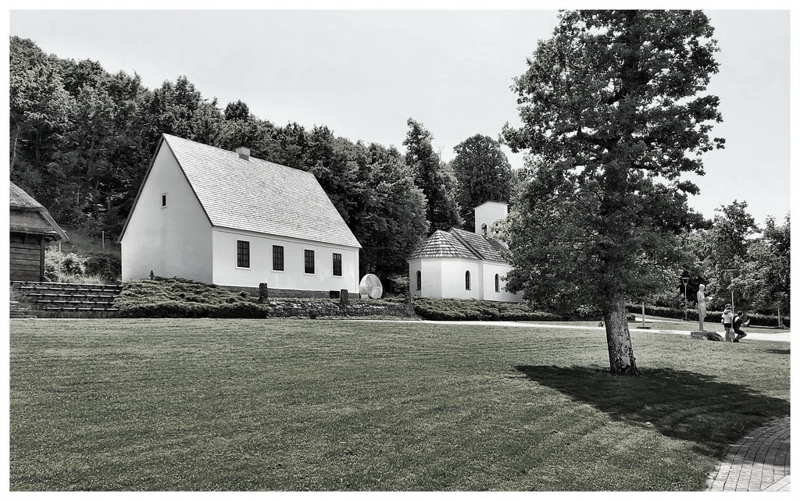
1856
Born in Smiljan

Slide 3
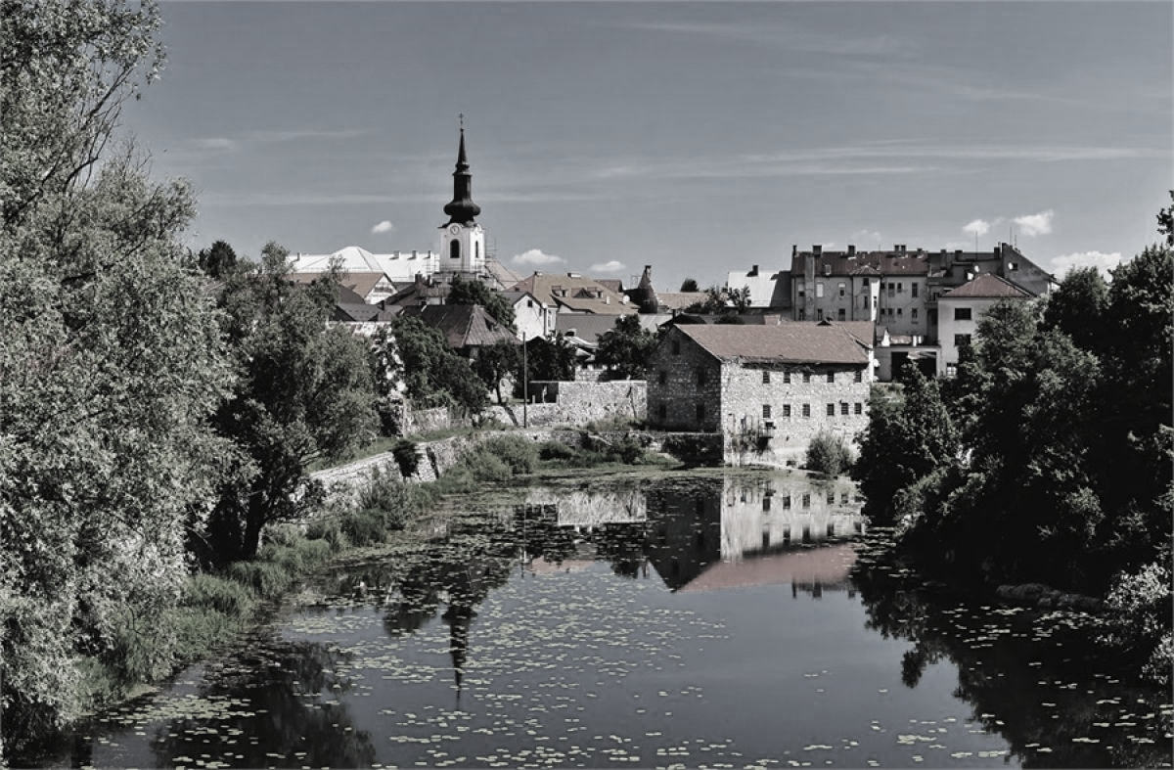
1865
Grown in Gospic

Slide 4
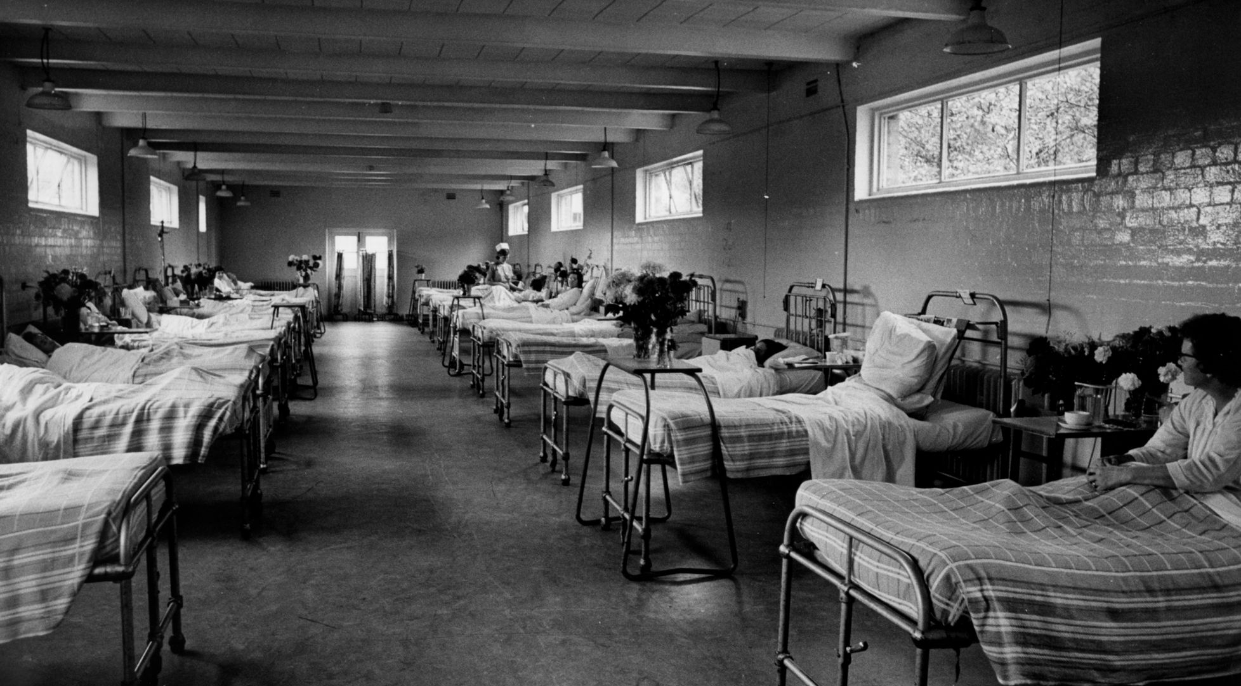
1875
Health issues

Slide 5
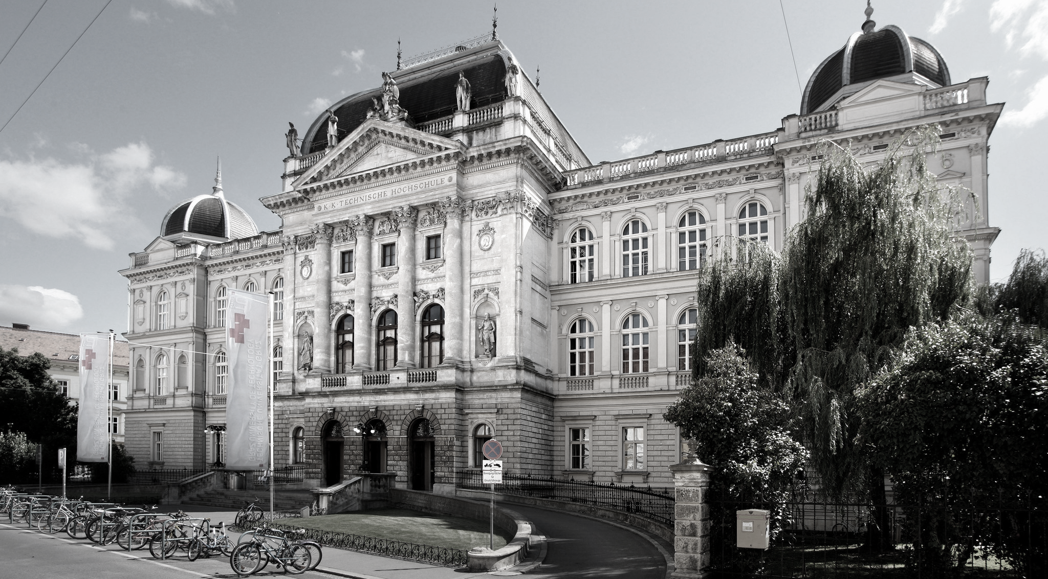
1881
Studies in Graz

Slide 6
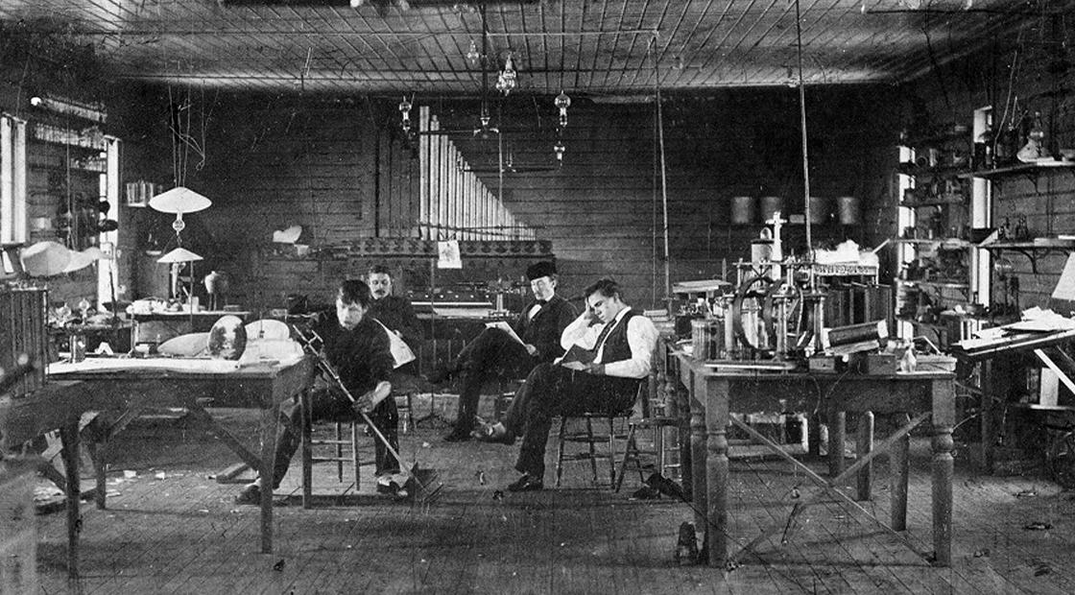
1885
His subordinate jobs

Slide 7
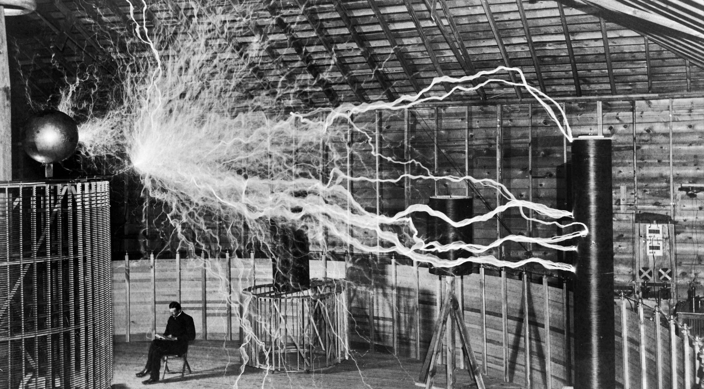
1943
His personal work and death

Slide 8
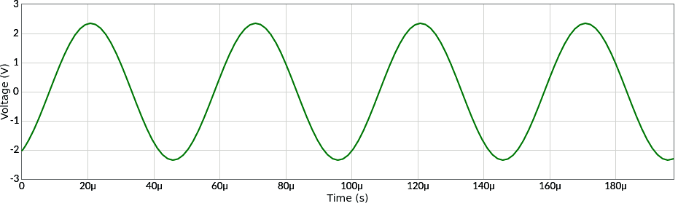
Alternating current
Alternating current periodically reverse direction, following a sinusoidal trend.
It’s used very often because it’s easier to transport than the direct current

Slide 9
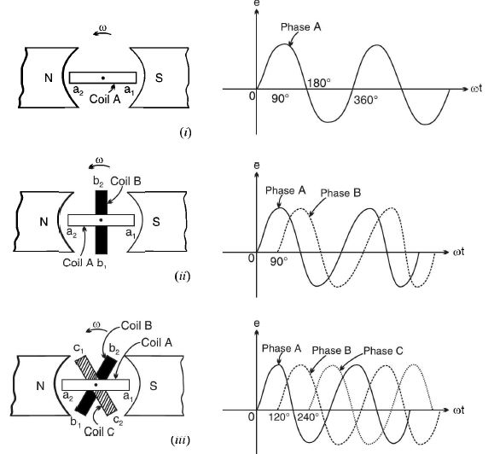
Three-phase
The three-phase system is the most used for AC production and distribution worldwide.
This arrangement ensures a balanced distribution of electrical power.

Slide 10
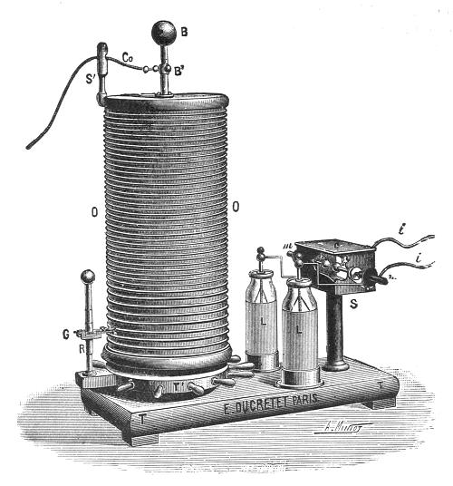
Tesla coil
The first prototype of Tesla coil consisted of a glass jar with a cable wound around.
Tesla used it to conduct experiments on X-Ray, phosphorescence, electrotherapy and electrical lightning

Slide 11
If you want to find the secrets of the universe, think in terms of energy, frequency, and vibration.
Nikola Tesla

